Slide 1
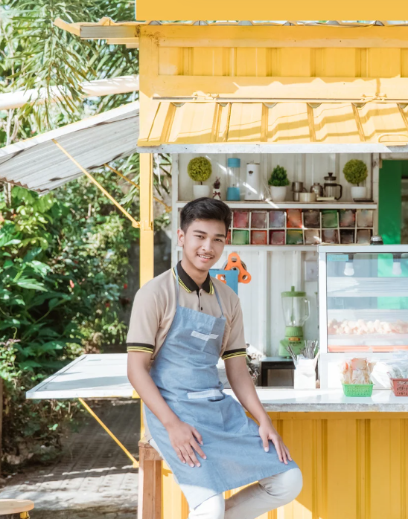
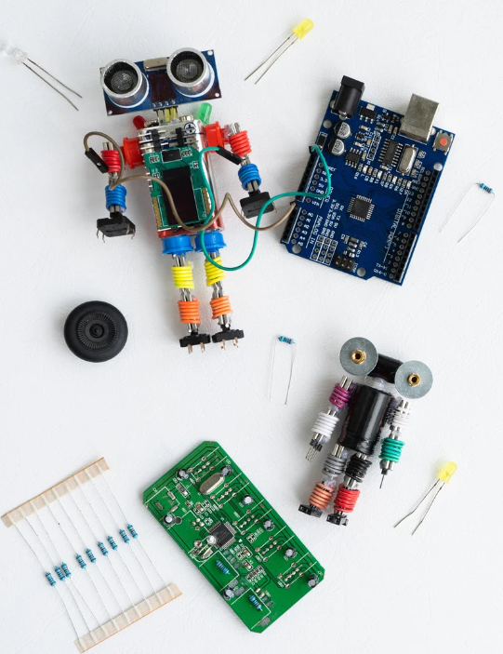
FUTURE SKILLS
Build Smart Farm Lab and upskill students with skills for the future.
ENTREPRENEURSHIP
STEM
GREEN SKILLS

